Slide 1

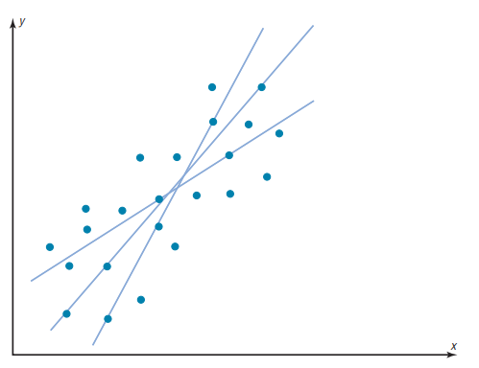

Why regression?
Regression analysis is used to understand and model the relationship between a dependent variable and one or more independent variables, allowing for prediction and understanding of how changes in independent variables affect the dependent variable.
The line of best fit, also known as the regression line or trend line, is a straight line that best represents the relationship between two variables in a dataset. It is determined by minimizing the overall distance between the data points and the line. Specifically, the best fit occurs when the sum of the squares of the vertical distances from each point to the line is at its lowest possible value.

Slide 2
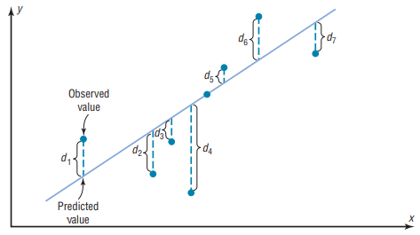
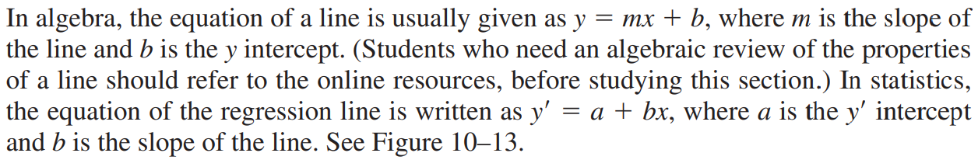
Residual and method of least squares
Residuals represent the difference between an observed value and the value predicted by a regression model, while the least squares regression line is the line that minimizes the sum of the squared residuals
Determination of the Regression Line Equation

Slide 3
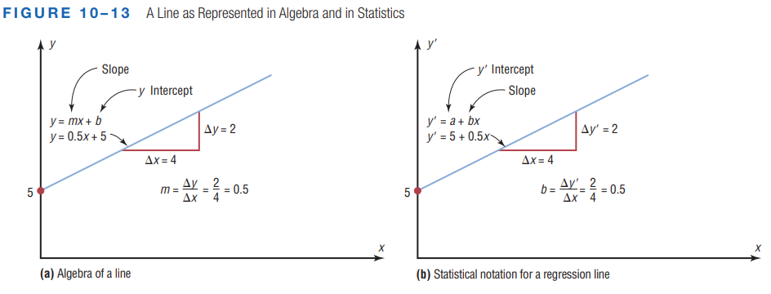
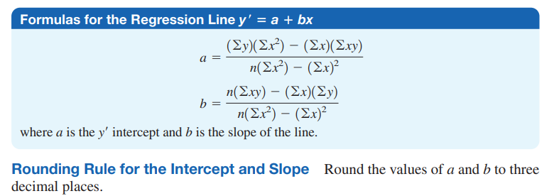

Slide 4
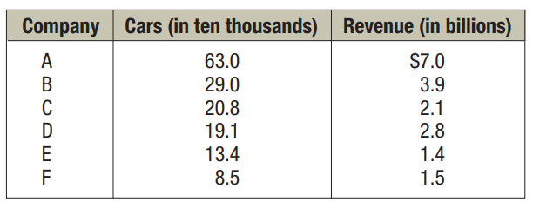
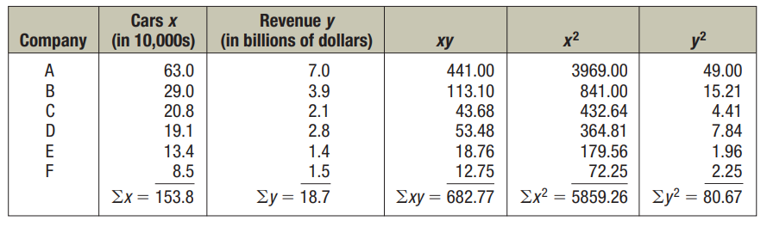
EXAMPLE 10–9 Car Rental Companies
Find the equation of the regression line for the data shown for car rental companies in the United States for a recent year, and graph the line on the scatter plot of the data.
Solution:

Slide 5
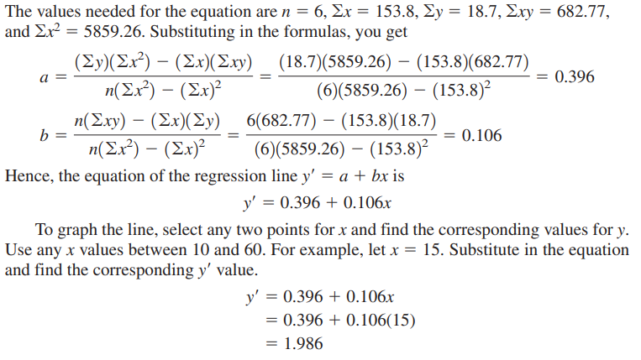
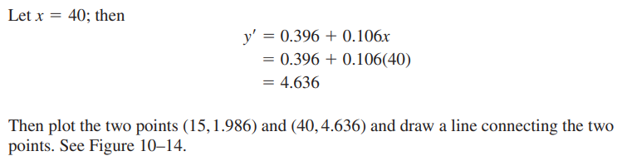

Slide 6
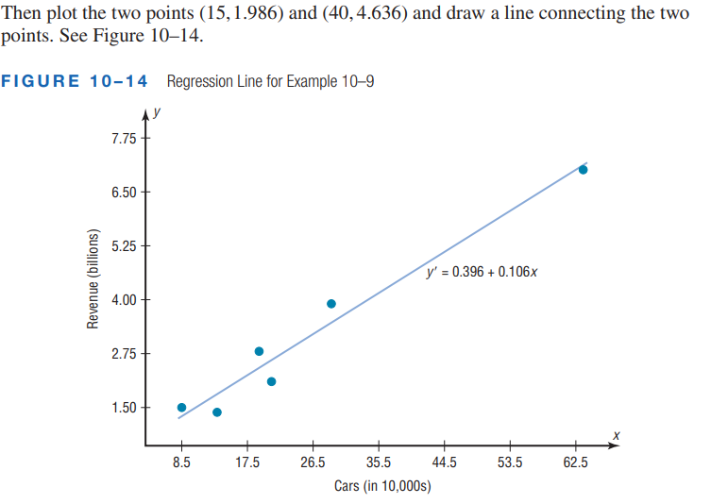

Slide 7
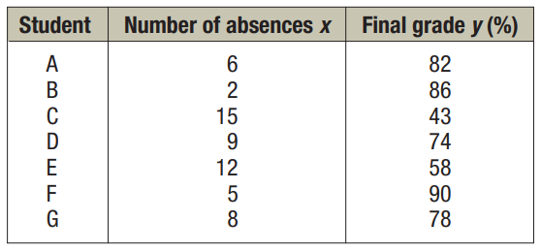
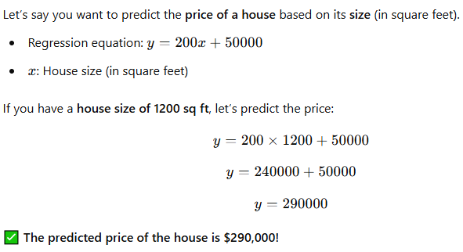
EXAMPLE 10–10 Absences and Final Grades
Find the equation of the regression line for the data obtained in a study on the number of absences and the final grades of seven randomly selected students from a statistics class, and graph the line on the scatter plot of the data.
Solution: Do yourself (Page-569, Reference book)
Prediction using regression equation

Slide 8
